Slide 1
UIT2502 – Data Analytics & Visualization
Logistic Regression

Slide 2
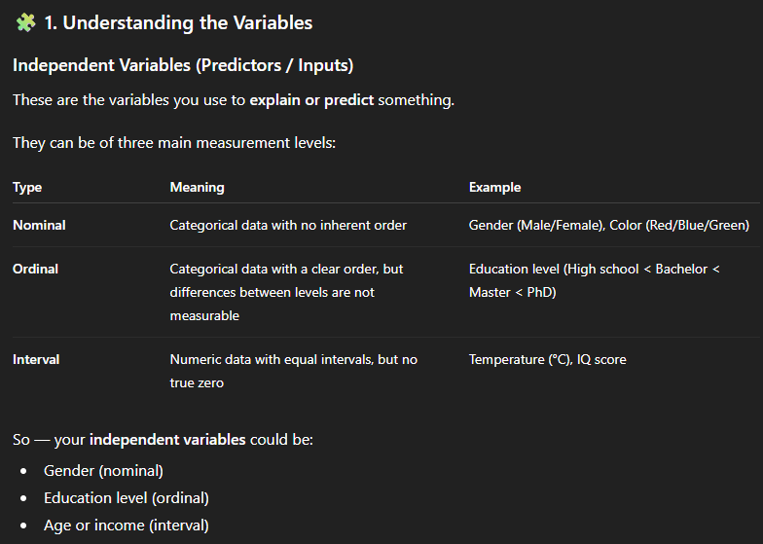
Logistic Regression
The independent variables can be nominal, ordinal, or of interval type and the dependent variable is discrete
It uses logistic or sigmoid function - value of this function lies between zero and one

Slide 3
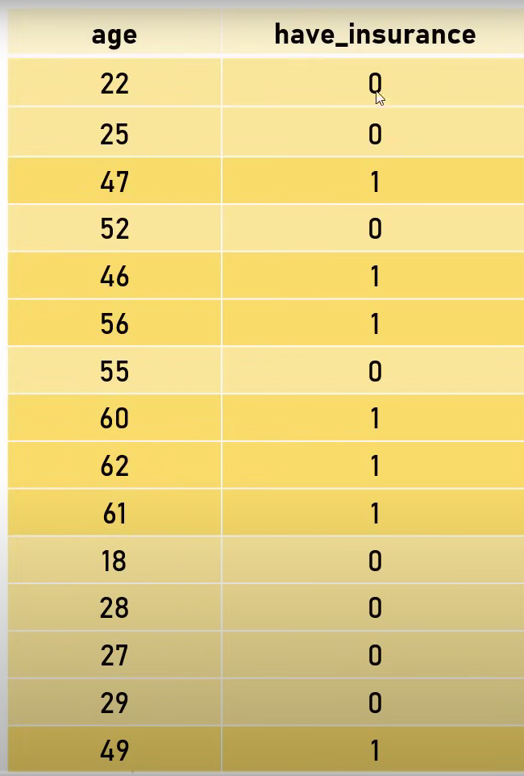
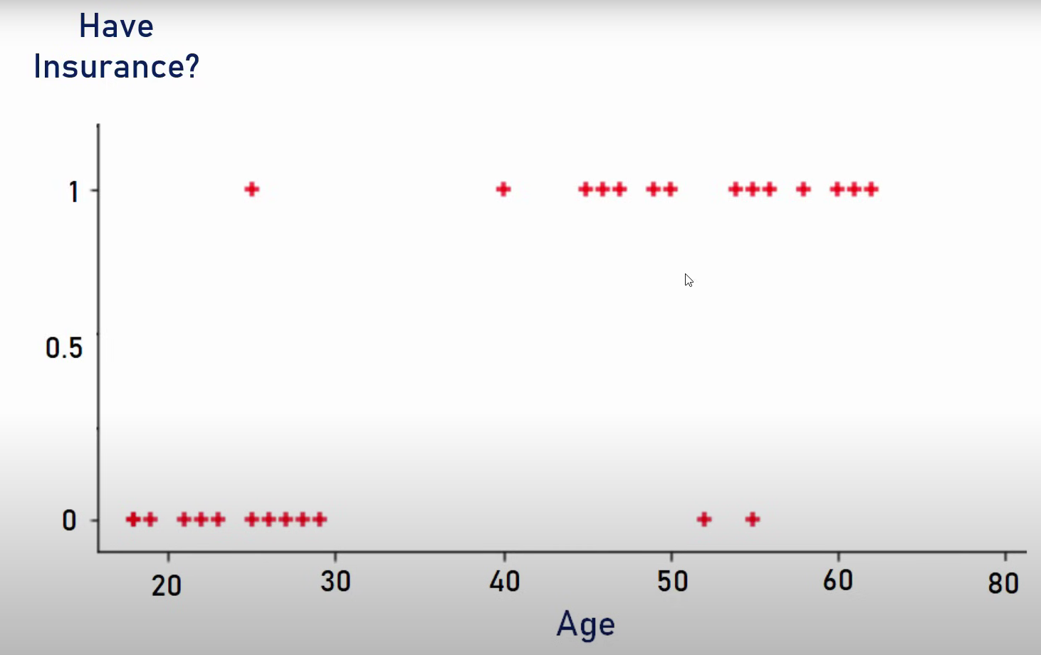
Logistic Regression

Slide 4
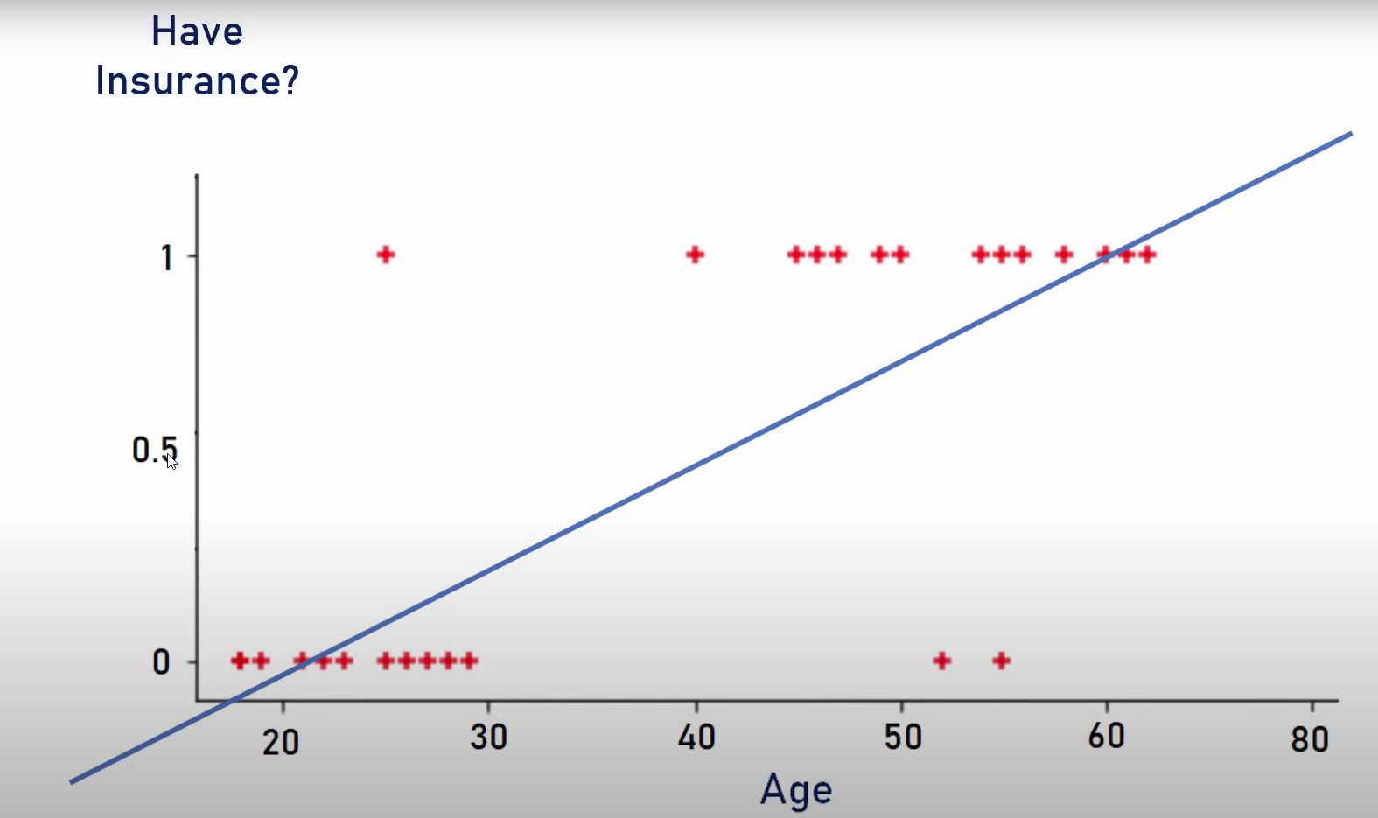
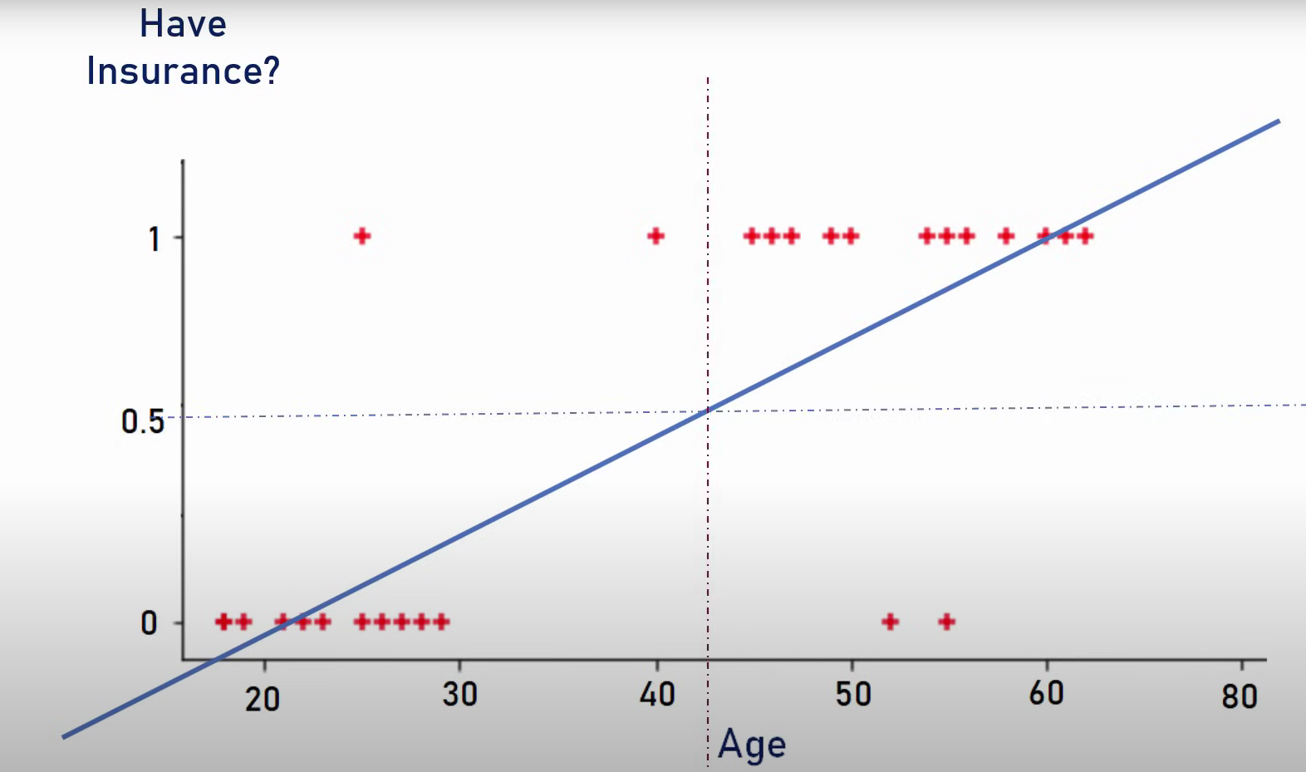
Logistic Regression

Slide 5
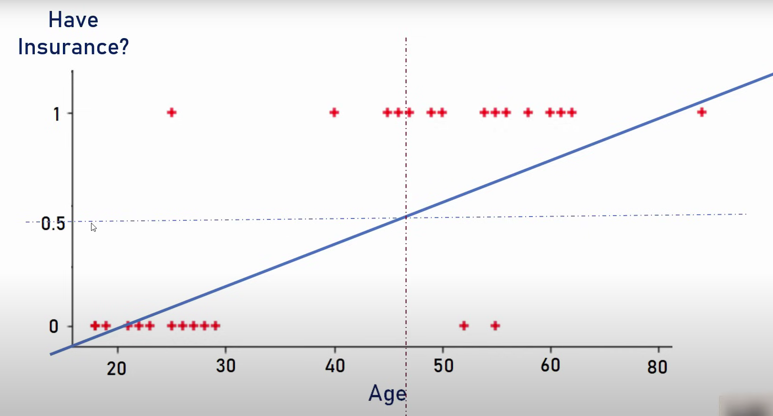
Logistic Regression

Slide 6
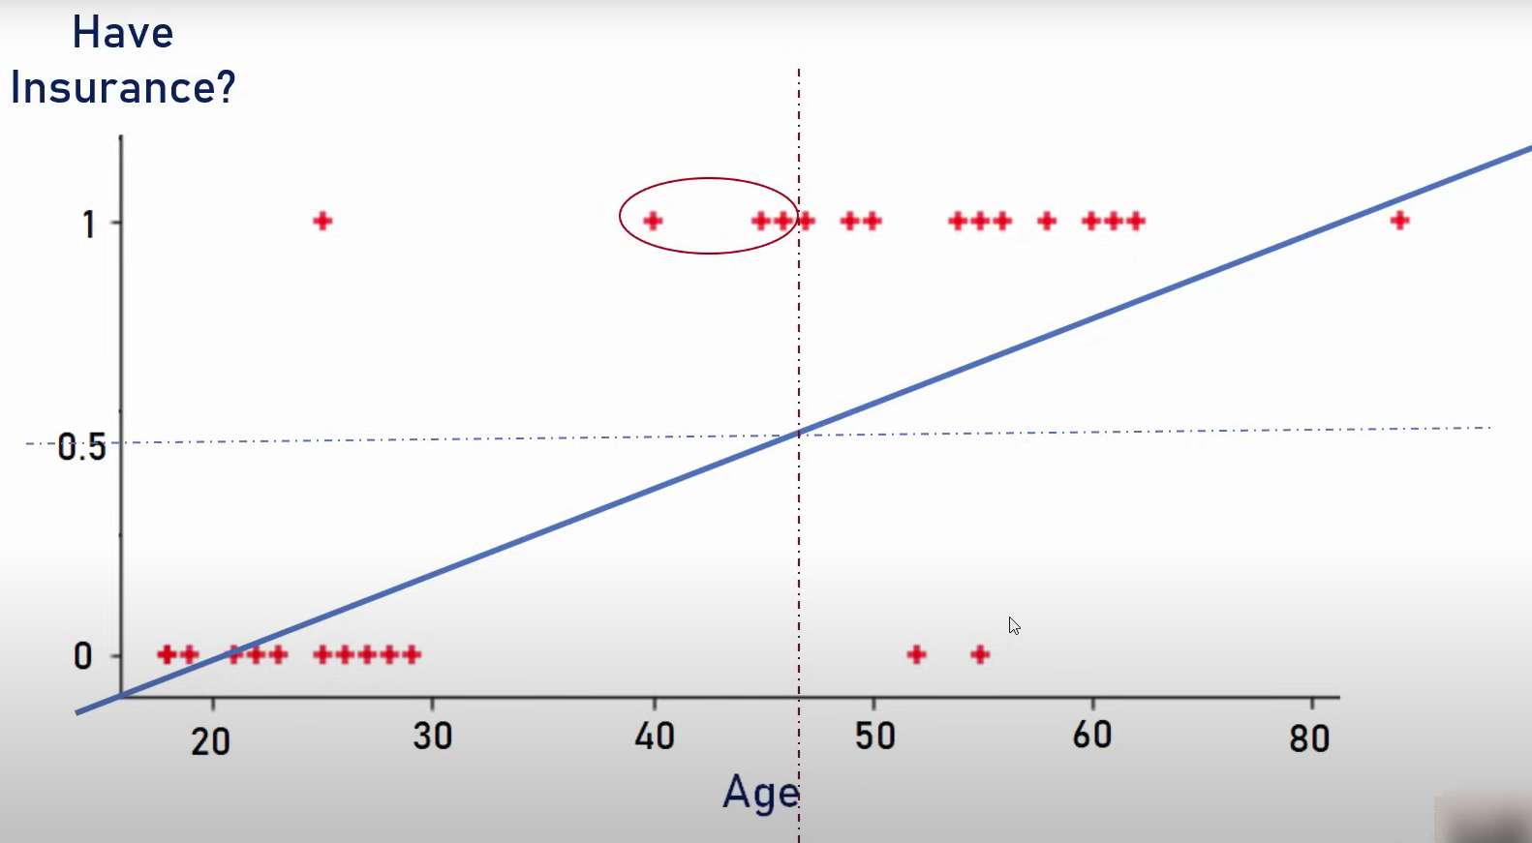
Logistic Regression

Slide 7
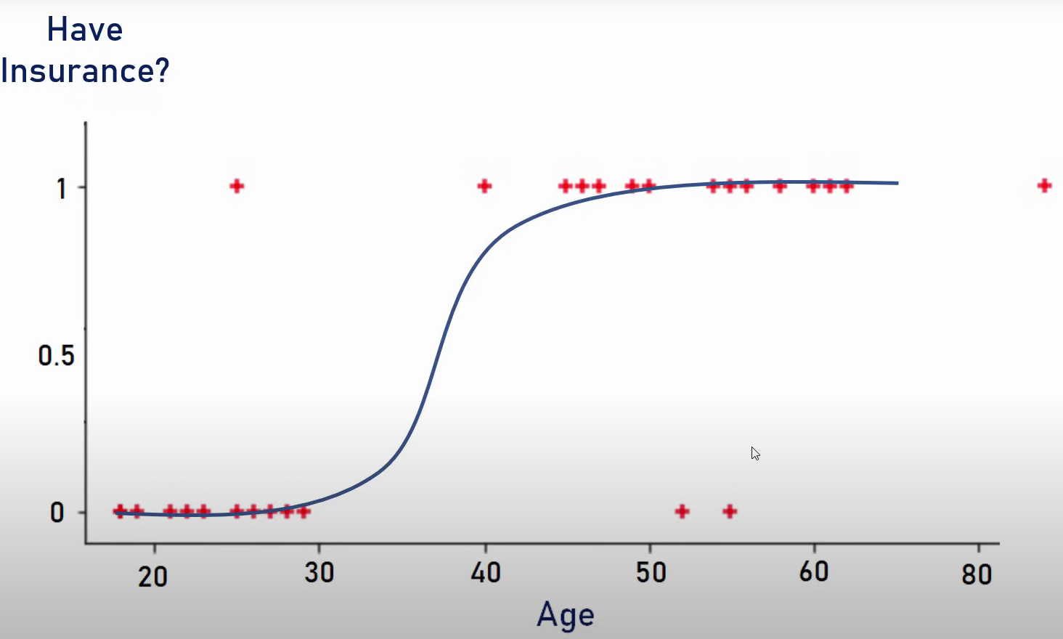
Logistic Regression

Slide 8
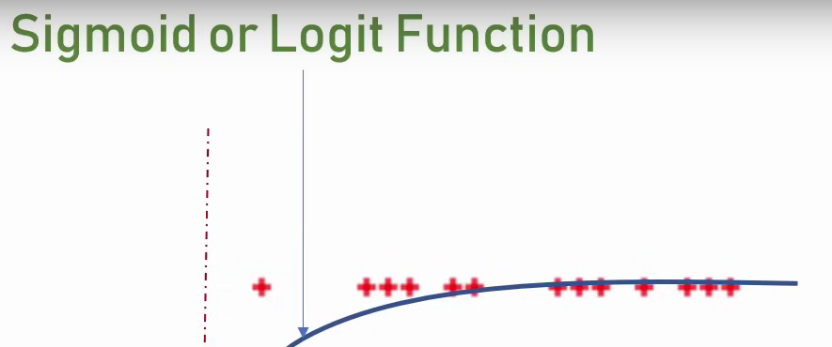
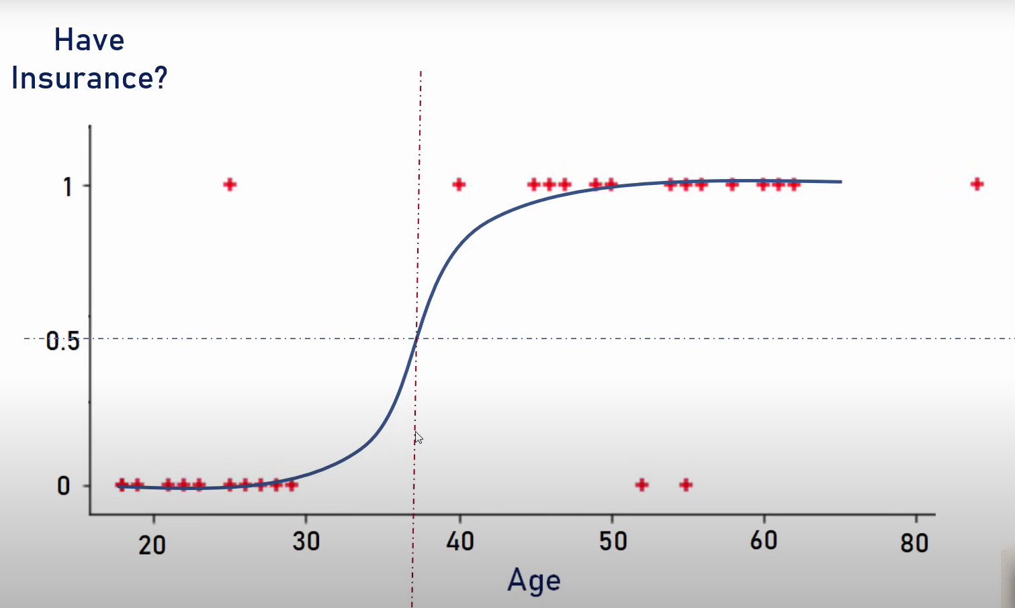
Logistic Regression

Slide 9
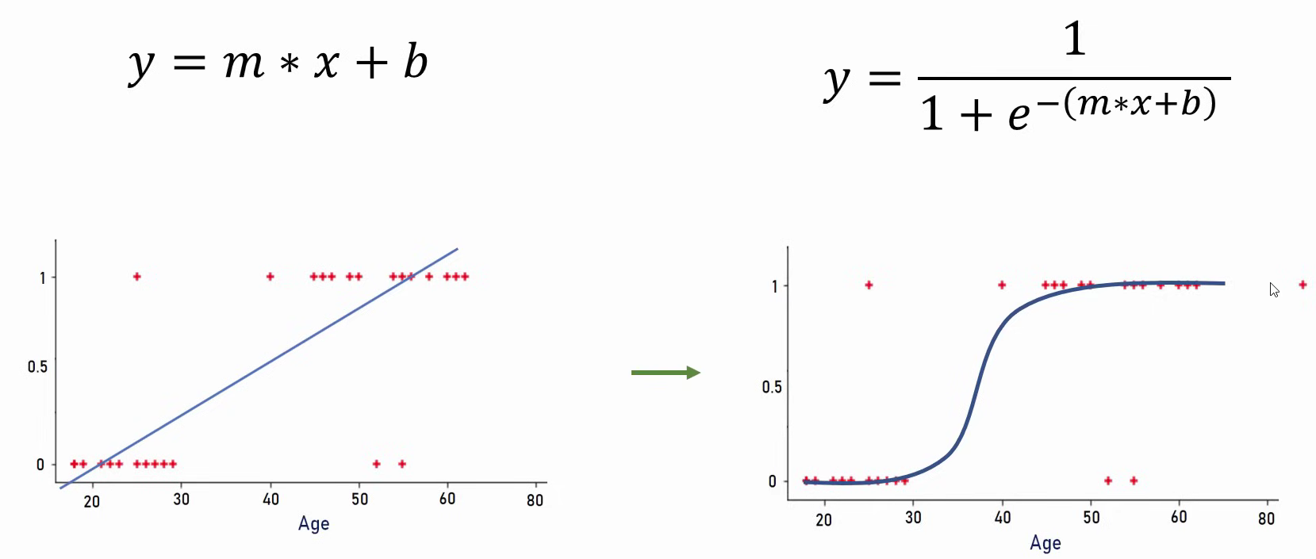
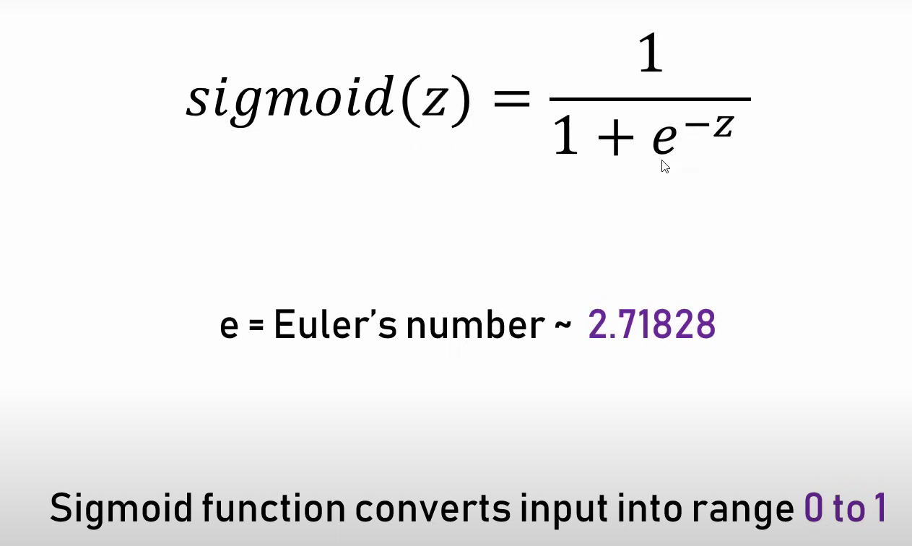
Logistic Regression

Slide 10
Types of logistic regression
Depends on the dependent/target variables:
Binomial
A binomial logistic regression (or logistic regression for short) is used when the outcome variable being predicted is dichotomous (i.e. yes/no, pass/fail). This model can be used with any number of independent variables that are categorical or continuous
Multinomial
A multinomial logistic regression (or multinomial regression for short) is used when the outcome variable being predicted is nominal and has more than two categories that do not have a given rank or order. This model can be used with any number of independent variables that are categorical or continuous.
Ordinal
This type applies when the dependent variable has three or more categories with a natural order or ranking. Examples include ratings like "low," "medium" and "high." It takes the order of the categories into account when modeling.

Slide 11
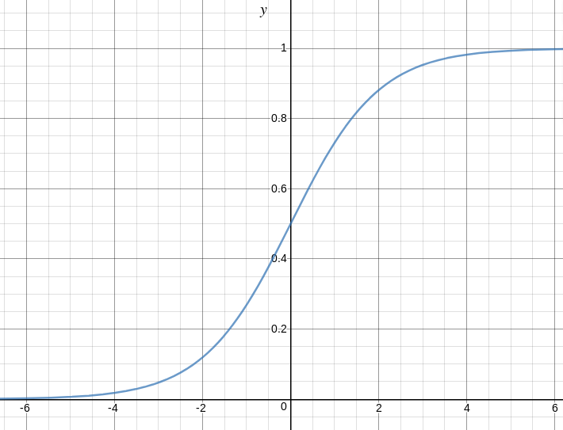
Sigmoid function

Slide 12
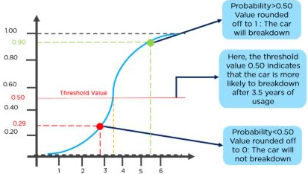
Example of logistic function

Slide 13
Summary
No residual analysis is done i.e. least square errors / no R-Squared metric
Uses maximum likelihood estimates

Slide 14
Books
TEXTBOOKS:
David Cielen, Arno D. B. Meysman, and Mohamed Ali, “Introducing Data Science”, Manning Publications, 2016. (first two chapters for Unit I).
Robert S. Witte and John S. Witte, “Statistics”, Eleventh Edition, Wiley Publications, 2017.
Jake VanderPlas, “Python Data Science Handbook”, O’Reilly, 2016.
REFERENCES:
Allen B. Downey, “Think Stats: Exploratory Data Analysis in Python”, Green Tea Press, 2014.

